Slide 1
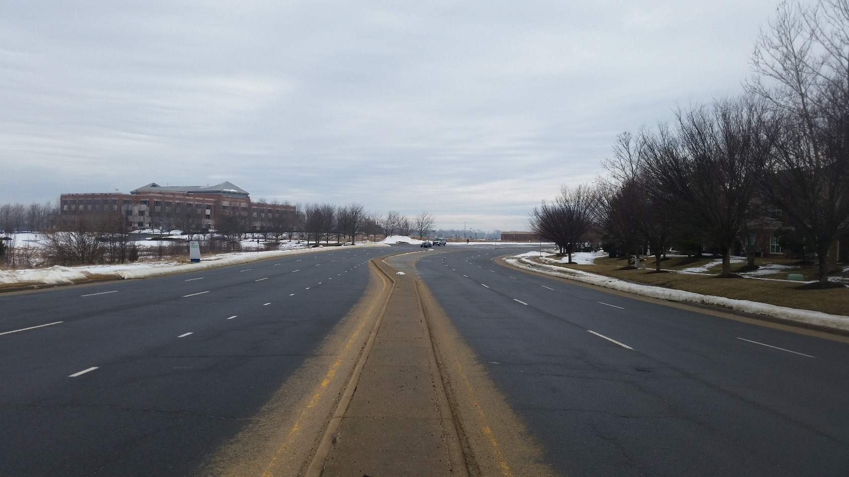
George Washington Boulevard Road Diet
Community Meeting
Monday April 20, 2015

Slide 2
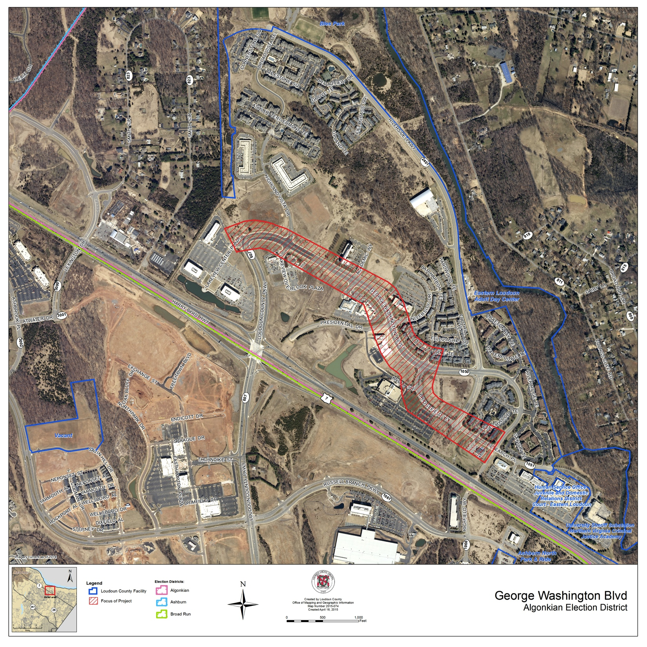
Vicinity Map
- Insert Map from Doug Gibson -

Slide 3
Challenges & Opportunities
Safety & Operations Enhancements
Crashes
Speed
Sight Distance
Driveway and side street entrances
Bicycle & Pedestrian Connectivity

Slide 4
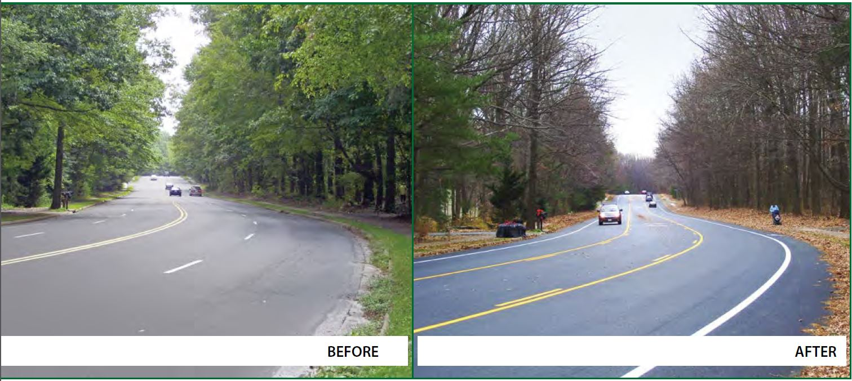
Road Diet
“Removing travel lanes from a roadway and utilizing the space for other uses and travel modes”
- FHWA Road Diet Informational Guide
Road Diet - Lawyers Road in Reston
Virginia Department of Transportation

Slide 5
Conceptual Drawings
Two corridor options presented for feedback from community; further engineering analysis required before VDOT approval and implementation
Improvements with on-street pavement markings only
Walk Through Concepts - Option A & Option B

Slide 6
Next Steps
Community Feedback
Implementation
Board of Supervisor support for funding
Design for VDOT approval
Implementation

Slide 7
George Washington Boulevard Road Diet
Community Meeting
Monday April 20, 2015

